Slide 1
Alternative Anaglyph Methods
Richard Hua
Feb 25, 2010

Slide 2
How anaglyph works
Viewing anaglyphs through appropriately colored glasses results in each eye seeing a slightly different picture.
Red/cyan glasses
The red lens allow only the red part of the image through
The cyan lens allow only the blue/green parts of the image through

Slide 3
Methods to produce Anaglyph Images
Assume we have two input images, noted as:
(R^{Left}, G^{Left}, B^{Left}) = left image
(R^{Right}, G^{Right}, B^{Right}) = right image
(R’, G’, B’) = merged resulting image
Original anaglyph (Color anaglyph):
(R’, G’, B’) = (R^{Left}, G^{Right}, B^{Right})
Partial color reproduction
Retinal rivalry

Slide 4
Issues
Inherited issue when doing color filtering by the glasses, only partial color reproduction can be achieved.
Retinal rivalry: when the two eyes are simultaneously or successively stimulated on corresponding retinal areas by dissimilar images, there results either an alternation of perception (complete or partial) or even a constant dominance of one eye.

Slide 5
Retinal Rivalry in Color Anaglyph
Red channel preserves purely left image’s red shape
Blue/green channels only represent right image’s blue/green shapes
In a stereoscopic pair, the shapes in perception are different and difficult for the brain to visualize the 3D scene.

Slide 6
Half Color Anaglyph
Assume x = left RGB, y = right RGB vectors.
HC(x)=(0.299*x.R + 0.587*x.G + 0.114*x.B, x.G, x.B)
(R’, G’, B’) = (HC(x).R, y.G, y.B)
Reduce retinal rivalry by using intensity of the left image instead of red channel only. Thus preserve more of the “shapes” in the left image when merged.
Less redness than color anaglyph

Slide 7
Optimized Anaglyph
(R’, G’, B’) = ((0.7 * x.G + 0.3 * x.B)^{Gamma}, y.G, y.B), where gamma = 1.5
Discard the red shape of the left image and take green/blue of the left image instead.
Almost no retinal rivalry.
No red shape reproduction in both eyes.

Slide 8
Half Color Anaglyph with saturation adjustment
S(x) is a function to increase saturation 150%.
(R’, G’, B’) = (S(HC(x)).R, S(HC(y)).GB)
Enhance colorfulness over half color anaglyph.

Slide 9

Color Anaglyph

Slide 10
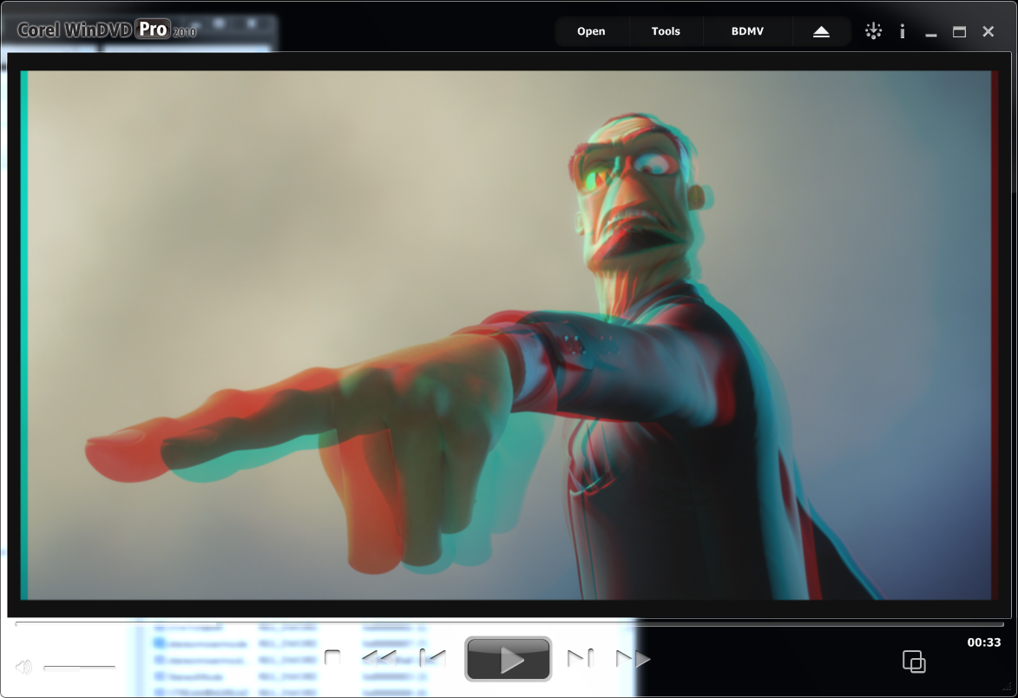
Half Color Anaglyph

Slide 11
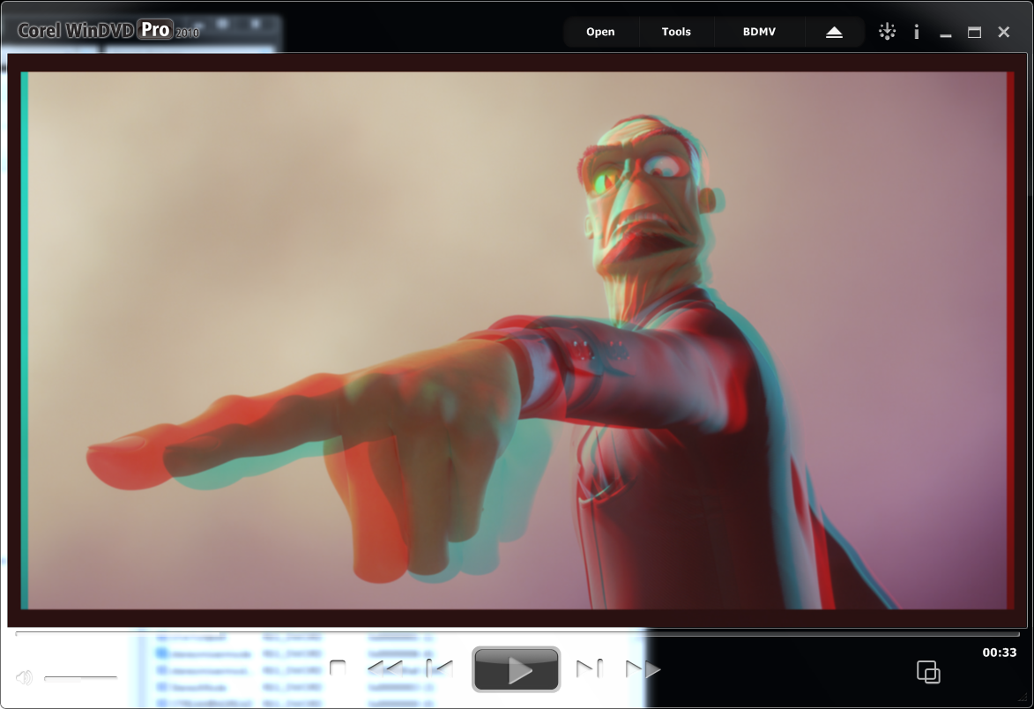
Optimized Anaglyph

Slide 12
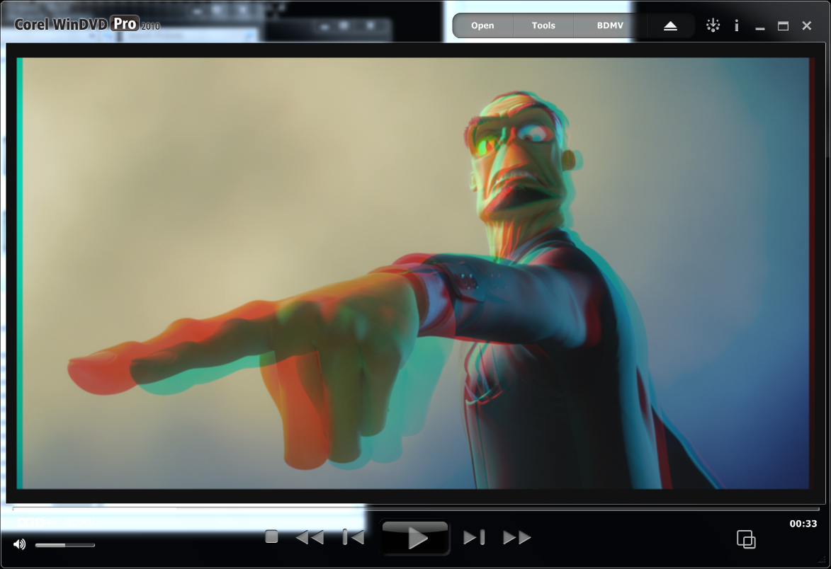
Half Color with Saturation Enhancement

